Slide 1
Wauchope High School
Three Core Values
Best Effort
Care and Respect
Safety at all times

Slide 2
Best Effort means:-
Excellent attendance
Consistent effort to be prompt
Engaging in all set work
Consistently being prepared with the correct equipment
Completing all homework
Completing all assignment work
Enthusiasm and conscientious application
Academic achievement

Slide 3
Care and Respect means:-
Speaking respectfully at all times
Following reasonable teacher instructions
Ensuring that the learning of fellow students is not interrupted
Reporting or stopping bullying or harassment
Respecting the property of others, including the school

Slide 4
Safety at all times means:-
Using all equipment safely
Not behaving in a way that could endanger self or others
Solving conflict without the use of physical aggression
Not bringing or using banned substances at school
Behaviour which infringes on the safety of others, such as harassment, bullying and illegal or anti -social behaviour of any kind will not be tolerated at any time.
Notes:
Think Pair Share
Talk to the person sitting beside you for 2 or 3 minutes – what kinds of things would seriously impact on the safety of others?
Who would like to share with the group?

Slide 5
A New Policy …
We are very aware that most students always meet our three core values of Best Effort, Care and Respect and Safety at all times.
Wauchope High School has a new wellbeing policy and there will be Year Assemblies which will explore the supportive and positive aspects of this policy, including one which will help students, staff and the school community to review the award system.
The new policy also includes new procedures for students who are not meeting expectations. Today is about those procedures for your information.

Slide 6
 | Excellent | What I should be doing | What I was doing
Best Effort | Encouraging others to be prompt to class and ready to start | Prompt to class and ready to start | Late
 | Actively supports other students to have correct equipment including uniform | Correct equipment including correct uniform | Does not have correct equipment
 | Goes beyond expectations in classwork, homework or assignment work | Met work expectations 100% Class work Homework Assignment | Worked below 65% of expectations Class work Homework Assignment
 | Conscientious application | Consistent application throughout the period | Poor application to work
Care and Respect | Pleasant, respectful and caring to all throughout the lesson | Speaking respectfully at all times | Disrespectful
 | Prompts others to follow reasonable instructions | Follows reasonable instructions | Failed to follow reasonable instructions
 | Helps others to learn when appropriate | Allows others to learn at all times | Disrupted the learning of others
 | Actively works to prevent bullying and/or harassment | Does not participate or rejects bullying and/or harassment | Bullying and/or harassing others
 | Actively prevents others from disrespecting/damaging property | Respects the property of others | Lack of respect for the property of others
Safety at all times | Helps others to use equipment safely when appropriate | Uses equipment safely | Unsafe
 | Actively prevents others from behaving in a way that endanger others | Behaves in a way that does not endanger others | Dangerous
 | Helps others solve conflict without the use of physical verbal/aggression | Solves conflict without the use of physical verbal/aggression | Aggressive, disrespectful to others
Notes:
What is different about this table?

Slide 7
If your behaviour is not meeting expectations …
An adult in the class (teacher, teacher’s aide, volunteers and visitors from education offices)
may look at you or come closer to give you a hint that you are not meeting expectations
may say your name or ask you what you should be doing to give you a hint that you are not meeting expectations
may move you or expect you to sit in a seating plan
may place you into a time-out of class arrangement for a defined period of time
ask you to return at lunchtime to catch up on work missed due to not meeting expectations
give you a green PBL Reflection Sheet – this will result in a lunchtime meeting with the teacher and a green card; anything else you have to do comes second
PBL Reflection sheets are sent home to parents along with the green card letter
Note: Sometimes students do not meet expectations in a serious way – this can result in immediate intervention of the Head Teacher of the subject. This may be followed by Deputy Principal intervention.

Slide 8
Wauchope High School – PBL Reflection
You have been issued with this plan because your behaviour has not met WHS expectations.
NAME: ____________________
YEAR: _______ DATE: ________
SUBJECT: __________________
TEACHER: __________________
I have been placed on this green card because I was not displaying:
□ Best Effort
□ Care and Respect
□ Safety at all times
What I should be doing (WHS minimum expectations)
Best Effort | Prompt to class and ready to start
 | Correct equipment including correct uniform
 | Met work expectations 100% Class work Homework Assignment
 | Consistent application throughout the period
Care and Respect | Speaking respectfully at all times
 | Follows reasonable instructions
 | Allows others to learn at all times
 | Does not participate or rejects bullying and/or harassment
 | Respects the property of others
Safety at all times | Uses equipment safely
 | Behaves in a way that does not endanger others
 | Solves conflict without the use of physical verbal/aggression
Please take the time to complete this plan carefully – failure to do so may result in a Yellow Card.

Slide 9
What were you doing? Was I warned?
_____________________________________________________________________________________________________________________________________________________________________________________________________________________________________________________________________________________________
Why were you doing it? How do we fix it?
____________________________________________________________________________________________________________________________________________________________________________________________________________________________________________________________________________________________________________________________________________________________
Student Wellbeing System
Step 1 - Green Card
Classroom Teacher – 5 lessons
Repeat by negotiation
Step 2 - Yellow Card
Head Teacher – 6 days
Repeat by negotiation
Step 3 – Red Card
Deputy Principal – 6 days
Repeat by negotiation
Step 4 - Suspension
Deputy and Principal
Notes:
I have had to speak to John Smith many times during the lesson about his constant calling out. My first warning was to look at him. My second was to ask him why I might be worried about his behaviour. The third time I handed him a green sheet. How would you fill it in. (Go back one slide for first half of sheet)
Discuss with the person behind you.

Slide 10
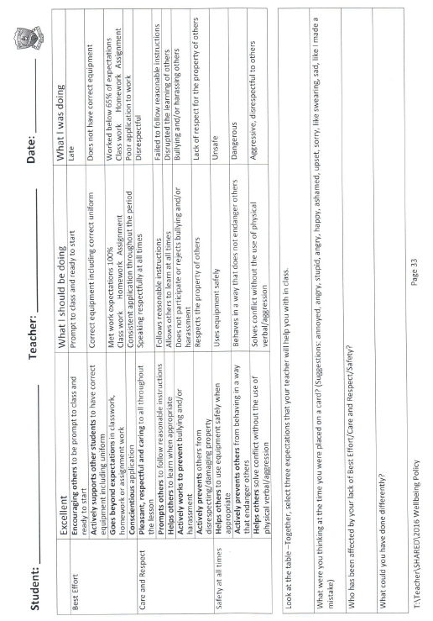
What happens next?
The teacher goes onto Sentral and records how you have not met expectations and sends a letter home with the green reflection sheet attached.
You meet with the teacher at lunchtime and complete the front of the green card.
What does a green card look like?

Slide 11
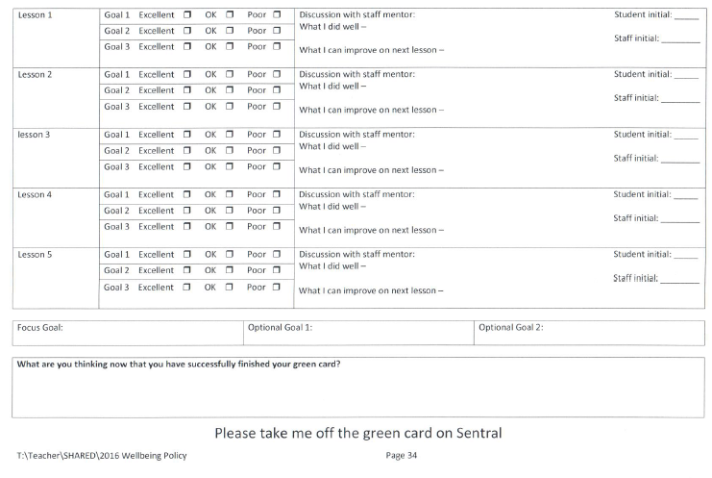
What happens next?
After you have set your goals together, the teacher and you will discuss and rate your behaviour. This will happen for 5 lessons.
If you fail to meet expectations your teacher will make further contact with your parents.
Two poor ratings will result in a discussion with the subject head teacher and a yellow card.
Two green cards in two different subjects results in a yellow card.
Notes:
True or false – True hands on head – false hands on bottoms
Wauchope High School has three core values – Best Effort, Care and Respect and Safety at all times? T – hands on heads
Excellent attendance demonstrates care and respect under our core values? F – hands on bottoms
(demonstrates best effort)
Consistently being prepared with the correct equipment means that I should have books, pens, pencils and specialist equipment for subjects such as TAS, Science and PE? T – hands on heads
Best effort is also about achieving academically? T – hands on heads
Care and Respect is really about how I treat others? T – hands on heads
Speaking loudly when I feel like it in class demonstrates care and respect to others? F – hands on bottoms
(it is not allowing other students to learn uninterrupted)
Walking away silently when a student is being harassed is demonstrating care and respect? F – hands on bottoms
(reporting bullying demonstrates care and respect)
Screaming and yelling at the bully is demonstrating care and respect? F – hands on bottoms
(this is not being respectful)
Everyone has a right to be safe at school? T – hands on heads
The new wellbeing policy is supportive of all students and is not only about those who do not meet expectations? T – hands on heads
Teachers warnings are always said out aloud and include the word “warning”? F – hands on bottoms
(a warning can be a look, a question related to your behaviour, a system of three strikes you are out on the board etc.)
The green sheet – the PBL Reflection sheet - helps me reflect on which core value I did not demonstrate? T – hands on heads
The green sheet is for discussion between myself and the teacher only? F – hands on bottoms
(it goes home to parents)
When I am on a green card my behaviour is rated in all of my lessons for 5 days? F – hands on bottoms.
(only in that subject)
If I do not meet expectations on the green card, I will be suspended? F – hands on bottoms
(you will discuss your behaviour with the subject head teacher.)

Slide 12
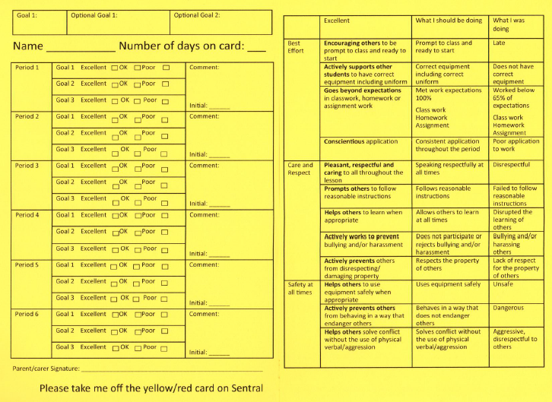
What does a yellow card look like?

Slide 13
What does being on a yellow card mean?
You and the subject head teacher will meet at lunch and set your goals. This will be recorded on Sentral and a letter will be sent home.
Your behaviour will be rated in all lessons for 6 days.
If your behaviour is not meeting expectations, you will need to discuss this with the subject head teacher who will also make further contact with your parents.
Lunch meetings every Tuesday and Thursday with Head Teachers in A1 where you will be required to work through a booklet related to your behaviour.
Roll call with the Deputy in E block every morning. On Monday and Wednesday this will take place after the assembly.
You will not be able to represent the school. You will not take part in sporting or cultural excursions or attend school socials without exception.
(Note: Your attendance and outstanding N-Notifications may also prohibit you from attending excursions or socials.)
Failure to meet expectations under yellow card mentoring will result in a red card.
Two yellow cards in two different subjects also results in a red card.

Slide 14
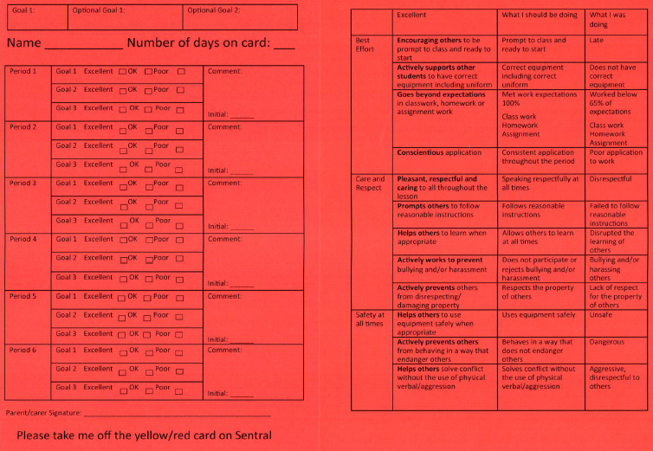
What does a red card look like?

Slide 15
What does being on a red card mean?
You and the deputy will meet and set your goals. This will be recorded on Sentral and a letter will be sent home which will include a formal caution of suspension.
Your behaviour will be rated in all lessons for 6 days.
If your behaviour is not meeting expectations, you will need to discuss this with the deputy who will also make further contact with your parents.
Lunch meetings every Tuesday and Thursday with the Deputy in E3 where you will be required to work through a booklet related to your behaviour.
Roll call with the Deputy in E block every morning. On Monday and Wednesday this will take place after the assembly.
You will not be able to represent the school. You will not take part in sporting or cultural excursions or attend school socials without exception.
(Note: Your attendance and outstanding N-Notifications may also prohibit you from attending excursions or socials.)
Failure to meet expectations under red card mentoring could result in a further consequences and/or a suspension.

Slide 16
Suspensions
Under most circumstances you will receive a formal written caution that you will be suspended if you continue not to meet expectations.
However:
(copied directly from the policy)
The policy lists such things as physical violence, weapons and illegal substances or when a substance is being represented as an illegal substance.
(copied directly from the policy)

Slide 17
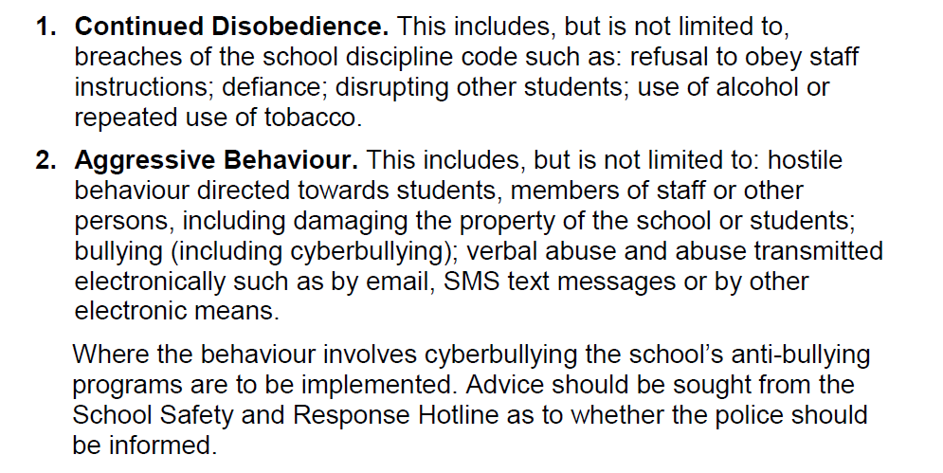
Short Suspensions

Slide 18
Long Suspensions
The suspension policy offers the following headings.
Physical Violence
Use or possessions of a prohibited weapon, firearm or knife
Possession, supply or use of a suspected illegal substance
Serious criminal behaviour related to the school
Use of an implement as a weapon
Persistent or serious misbehaviour
Persistent misbehaviour is described as:
Repeated refusal to follow the school discipline code
Behaviour that deliberately and persistently interferes with the rights of other students to learn or teachers to teach including bullying, harassment and victimisation.

Slide 19
A final word of caution …

